Slide 1





Oregon’s Workforce System
House Higher Education and Workforce Committee
February 14, 2017

Slide 2
Part of the Nation’s Workforce System
US Dept. of Labor
US Dept. of Education
US Dept. of Health & Human Services
US Dept. of Agriculture
BOLI
Apprenticeship
OED
WorkSource Oregon (WSO)
Unemployment Insurance
Labor Market Information
Research
HECC
WIOA Grant Administration
Community Colleges
Private Career Schools
Universities
Private Universities
Scholarships
Research
Commission for the Blind
DHS
Self Sufficiency Programs
Vocational Rehabilitation
WorkSource Oregon (WSO)
Local Workforce Development Boards
Community Based Organizations
Community Colleges
Economic Development
Notes:
This slide represents the complexity of the workforce system and includes a high level overview of the state agencies and local partners who participate in the system. I don’t want to go into great detail here except to say that one of our main goals at the state level is to work with our partners and align this work so that we don’t have multiple programs delivering the same service – as you can see, we have a great deal of work to do in achieving that goal.
To move that forward, there is an effort happening over the next several months to start that alignment conversation State leaders from the Department of Human Services, Self-sufficiency programs and vocational rehabilitation along with the employment department and the office of Community Colleges and Workforce Development have been going around the state and convening a local conversation in each of the nine local workforce areas to make an action plan for a strong partnership, alignment of the system and streamlining services to job seekers and businesses.
This group will be developing a set of guiding principles for the system, providing their vision for governance and delivery of the system and supporting the local implementation.
As this work moves forward other partners will be included in the alignment work.

Slide 3
Workforce System Services
Individuals
Work readiness skills
Job placement
Career advising
Workplace accommodations
Adaptive technology
Academic advising
Adult Basic Education
Training
Continuing education
Certificates and Degrees
Supportive services
Mental health services/referral
Coordinate local services
Financial safety net
Notes:
UI is a financial safety net, has some special programs for people in training who are becoming entrepreneurs
UI system, in determining if people are eligible for benefits, can identify barriers people may face to being as productive as possible in the work place and help connect them to workforce partners that can then provide appropriate supports

Slide 4
Workforce System Services
Business
Convene Sector Partnerships
Assess skill needs
Refer qualified job seekers
Customized workforce training
Small business development
Work-based learning
Internships
On-the-Job Training
Apprenticeship
Wage subsidies
Tax credits
Worksite adaptations
Train for use of adaptive tech
Business development
Oregon’s Workforce System
Notes:
UI has WorkShare, a tool to help some businesses avoid layoffs during temporary economic downturns

Slide 5
Workforce System Governance
Oregon Workforce Investment Board
Oversight of the workforce system
Hold system accountable for results
Recommend policy to the Governor
Feedback to agencies and workforce boards
34 member, majority business
http://www.oregon.gov/owib/Pages/index.aspx
Oregon’s Workforce System

Slide 6
All Oregonians need to possess the skills and abilities to thrive in the workplace
++
Training and services must be adaptable and inclusive
Special emphasis on:
Rural communities
Families experiencing multi generational poverty
Communities of color
Oregon’s Workforce System

Slide 7
Workforce System Goals
Workforce system is aligned, integrated, efficient and effective to support businesses and job
Businesses have skilled workers to innovate and grow
Oregonians have the skills for high wage/high demand jobs
Provide young people with information and experiences to spur further career development and connect to Oregon employers
Oregon’s Workforce System

Slide 8
Local Workforce Development Boards
Develop local Strategic Plans
Labor market research and analysis
Convene, broker and leverage
Business engagement
Develop career pathways
Identify and promote best practices
Use technology to maximize access
Oversee and negotiate local program performance
Oregon’s Workforce System

Slide 9
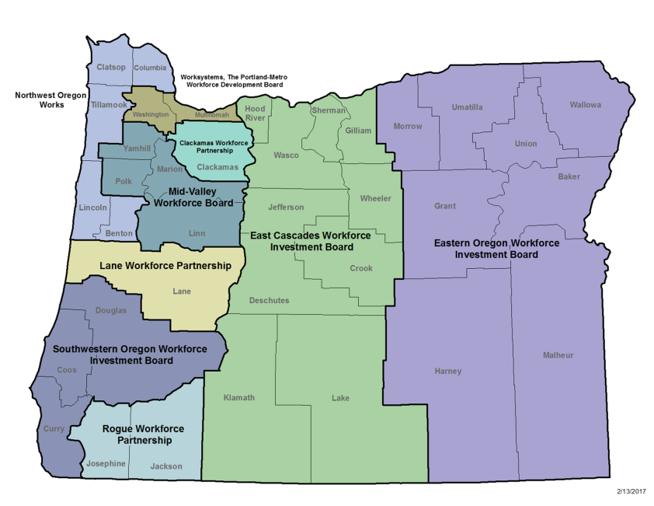
Local Workforce Boards

Slide 10
higher education coordinating commission & state structure
Public Board/Commission
State Agency
State Education Partners
Higher Education
Coordinating Commission
Oregon Governor
Oregon Legislature
Chief Education Office
State Board of Education
Oregon Department of Education
Employment Department
Oregon Workforce Investment Board
Oregon Youth Conservation Corps Advisory Board
Research &Data; Executive Director, Policy, and Communications; Operations,
​Office of Student Access and Completion (OSAC)
Public University Coordination
Workforce Investments
​​Community Colleges and Workforce Development (CCWD)
Private Postsecondary Education
HECC Commission*
HECC Agency*
9 Local Workforce Development Boards
Clackamas Workforce Partnership
East Cascades WIB
Eastern Oregon WIB
Lane Workforce Partnership
InCite, Inc. (Mid-Valley)
Northwest Oregon WIB
Rogue Workforce Partnership
Southwestern Oregon WIB
Worksystems, Inc. (Portland-Metro)
Oregon Youth Conservation Commission (OYCC)
Community Stewardship Corps (CSC)
Summer Conservation Corps (SCC)
Established in 2011 and vested with its current authorities in 2013, the HECC is a 14-member volunteer commission​ appointed by the Oregon Governor, with nine voting members confirmed by the State Senate. The Commission is supported by an Executive Director who oversees the eight offices of the HECC agency.
Notes:
Note that in this presentation we’ll focus specifically on the work of community colleges and Workforce Investments and how they fit in the workforce system…

Slide 11
Adults and dislocated workers
Adult Basic Education
    General Education Development (GED)
Career & Technical Education (CTE)
Training
    Certificates
    Career Pathways
    Degrees
Work Experience
    On the Job Training
    Internships
    Apprenticeship

Slide 12
Adult Basic Education (WIOA Title II)
Funding:
US Department of Education: Office of Career Technical and Adult Education (OCTAE)
Approximately $5 million for Oregon annually
Population Served:
  Adults (ages 16 to 61)
  Beyond age of compulsory school attendance;
  Do not have a secondary school diploma or its equivalent
  Not enrolled in secondary school

Slide 13
Adult Basic Education (WIOA Title II)
Program Outcomes:
  Demonstrated improvement in literacy skill levels
    Reading, writing, and speaking English, numeracy, problem solving, English language acquisition and other literacy skills
  Placement or retention in or completion of: Postsecondary education, training, unsubsidized employment or career advancement
  Receipt of secondary school diploma or equivalent
Current providers:
  Oregon Community Colleges & Department of Corrections
Notes:
Program Year
Students Served
2009-10 18,442
2010-11 18,386
2011-12 18,994
2012-13 19,240
2013-14 19,171
2014-15 17,756
2015-16 18,384

Slide 14

General Educational Development (GED)
A total of 9,100 students took GED tests in 2016
  66% were unemployed
  73% reported annual income of $5,000 or less
  39% reported a family member influenced them to obtain
  their GED.
  58% of students were male
  The average age of GED Test takers: 24
James: Veteran, Father, GED Completer,
Nursing Student
Source: GED Testing Service

Slide 15
Career and technical education
Career & Technical Education (CTE):
Educational programs that specialize in the skilled trades, applied sciences, modern technologies, and career preparation.
CTE programs offer academic and career-oriented courses to gain work experience, job shadowing, on-the-job training, and industry certification opportunities.
Cutting edge, rigorous and relevant career and technical education (CTE) prepares youth and adults for a wide range of high-wage, high-skill, high-demand careers.

Slide 16
Career Pathways
A series of connected education programs and student supports enabling individuals to get the training they need to secure a job or advance in a demand industry or occupation.
Goals
Increase the number of Oregonians with certificates, credentials and degrees in demand occupations.
To ease student transitions from high school to community college and from pre-college to credit postsecondary.
“My life has been irrevocably changed for the better. It’s like the opposite of stepping off a cliff. I have been abruptly propelled skyward.”
-Alan, student at PCC upon completing career pathway training
Notes:
Career Pathways Certificate of Completion – An Oregon Community college credential comprised of 12-44 credits embedded within an approved Associate of Applied Sciene (AAS) Degree, providing specialized training and education with a specific occupational focus.
Definition is from US Departments of Education and Labor (2012). Found here: http://www.ode.state.or.us/teachlearn/pte/careerpathwaysglossary.pdf
450+ offered statewide right now
In addition, CC’s have advisor groups

Slide 17
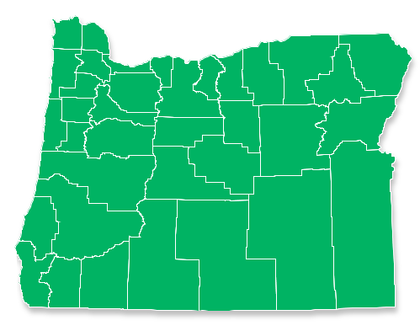
2016 Completions
47
Degree Granting Private
Postsecondary Schools
1,871³
17
Public Community Colleges
21,647
46,163¹
Total Degrees/Certificates Earned
at
Oregon Public Institutions
201
Private Career Schools
5,862⁴
8²
Public Universities
24,516
Includes Oregon Transfer Module, 1-2 yr. certificates, Associate/Bachelor/Master/PhD degrees, Post-doctoral and professional certificates.
Includes OHSU.
Total completions from 18 of the 24 Oregon-based regulated schools who reported data or reported it correctly for the 2015-16 academic year.
Total completions from 97 of the 201 Oregon-based schools who have reported data or reported it correctly for the 2015-16 academic year.
Notes:
* Legacy student data was collected during the fall of 2016 from private postsecondary institutions serving Oregon students. Preliminary totals do not include those institutions who have yet to report, those who are not required to report, or who may have closed prior to Fall 2016. These totals reflect what has been reported to HECC as of December 22nd, 2016.

Slide 18
Adults, dislocated Workers (WIOA TI)
$25 million annually
Population served
  18+
  Low Income Adults
  Dislocated Workers
    Lost job due to no fault of their own

Slide 19
Services adults and dislocated workers
Work readiness skills
Industry recognized certifications
  National Career Readiness Certificate
    ACT Certified Work Ready Communities
Work Experience
  On the Job Training
    Back to Work Oregon
Apprenticeships
Notes:
The NCRC is a national credential used to demonstrate the job seekers aptitude for work readiness
The American Council on Education recognizes the NCRC as a transcript for 3 college level credits
All Counties in the state of Oregon are offering the NCRC
The National Career Readiness Certificate is being promoted in partnership with Local WorkSource Offices, OED,CCWD and all Local Workforce Investment Boards
The goal for this program is to equip job seekers with the NCRC to display the talent pool, create a better opportunity for “right fit” job placement, and draw new business to Oregon
There has been a 72% increase in NCRC’s earned resulting in 37,937 credential holders since 2011
140 Schools in Oregon are utilizing the NCRC to meet Essential Skills Requirements in Reading and Math resulting in an increase in HS student Diploma attainment
Job Seekers earning the NCRC have Continued to sustain higher wages and higher retention
The NCRC is actively being accepted for 3 College credits at level silver and higher
National, Portable Credential
Validate skills, display Oregon’s Talent Pool, assist employers in hiring and draw new business to Oregon
Meets high school diploma requirements for math and reading
Certified Work Ready Communities match employers with skilled job seekers for economic growth
ACT sets goals for each County based on size and number of businesses
Union County
Clatsop County
Lane County
Exploring Oregon Work Ready Communities
Provides paid On-the-Job Training (OJT)
Participants earn an NCRC
Reimburses employers for part of the training costs
485 employers participated in 2013-14
1,351 job seekers have been enrolled and 1,338 have completed training for permanent employment

Slide 20
Adult and dislocated worker
Performance Measures
Employment, Earnings, Retention
Measureable Skills Gain
Credential Attainment
Certificates
National Career Readiness Certificates (NCRC)
On the Job Trainings
Employment, Wages, Retention

Slide 21
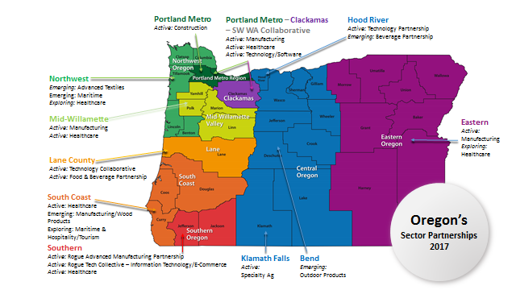
Oregon’s Industry Sector Strategies

Slide 22
Industry Sector Strategies
Foundation for how we engage with students, job seekers and businesses
Locally and employer driven
Highly responsive to industry demand
Solution oriented not program oriented
Interdependent versus independent approach
Industries collectively versus individually

Slide 23
Young oregonians
Youth who are not working are missing:
Preparation for self-sufficiency later in life
Development of work ethics
Opportunity for career exploration
Income that can be saved for future needs
Source:– Endangered: Youth in the Labor Force
Notes:
Youth employment crisis
Disproportionate share of overall unemployment
Youth accounted for 29 percent of Oregon’s unemployed in 2013
Postponing work Experience harms young workers’ ability to compete for jobs. Helping teens find and be successful in their first work experiences could improve their long term labor market outcomes.

Slide 24
Strategies to serve young people
Federal Youth Programs- $11m
Oregon Youth Conservation Corps- $1.3m
Summer Conservation Corps
Community Stewardship Corps
Notes:
Funding-
OYCC – youth gain paid summer employment opportunities or valuable education, employment and leadership skills while learning work ethic and environmental knowledge through integrated classroom and field-based learning projects.
NCRC – Recognized by the Oregon Department of Education as an alternative assessment to meet the Essential Skills graduation requirements in math and reading.
The NCRC is a credential valued by over 2050 employers in Oregon and may qualify students for 3 college credits
Students who have earned their NCRC share they have increased confidence in interviews with potential employers and those employers recognize the commitment the student has made to be work ready

Slide 25
Young people performance Measures
HS Completion (Degree or Certificate)
Entered into Education or Employment
Literacy and Numeracy Gains
Wages
OYCC Hours Worked
High School Diploma Essential Skills Requirement (NCRC)

Slide 26
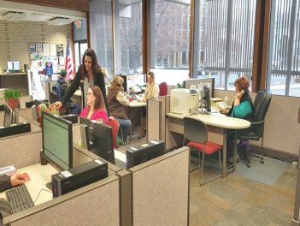
Oregon Employment Department
Workforce Operations
Jim Pfarrer, Division Director
Support Business ∙ Promote Employment
Notes:
Chair Reardon, Co-Chair Whisnant, Co-Chair Alonso-Leon and members of the Committee
Good Afternoon, my name is Jim Pfarrer. I am the Workforce Operations Director at the Oregon Employment Department.

Slide 27
Workforce Operations in Action
Business Services
  51% of customized listings close with a hire.
  85% employer satisfaction rate
Work Opportunity Tax Credit - Policy Package #103
  Processed $96,502,400 in tax credits to Oregon employers
  50,000 Oregonians were hired
Veteran’s Employment Assistance
  Served 19,165 veterans
Reemployment and Eligibility Assessment (REA)
  Conducted 64,847 REA claimant interviews
Support Business ∙ Promote Employment
Notes:
Business Services
Our Business Services team establishes effective relationships with businesses to match skilled, talented workers to the needs of the business. The relationship is built on in-depth understanding of the requirements of the employer and the skill base of our job seekers. Business Service Staff advocate on behalf of Oregonians with barriers to employment while promoting high growth, locally identified, business sectors. Went from 18% to 51% of customized business services job listings closed with one or more hires.
UI has WorkShare, a tool to help some businesses avoid layoffs during temporary economic downturns
Work Opportunity Tax Credit Program
The Work Opportunity Tax Credit focuses on helping populations with barriers move off public assistance programs and connect to employment through hiring incentives. 50,000 Oregonians were hired in Program Year 2015. $X was paid to employers in the form of a tax credit. The request for 3 WOTC staff will enable WO to reach out to more employers to encourage them to give workers with barriers to employment meaningful jobs. So far only 6% of Oregon’s employers have used the credit.
We will also train WSO staff who will help qualified job seekers use the credit as a tool to break out of poverty into living wage jobs
Veterans’ Program
A program designed to meet the employment and training needs of service-connected disabled veterans, and other eligible veterans by providing the maximum level of employment and training opportunities through specially trained veteran employment specialists. 37,632 veterans were placed in jobs through WorkSource Oregon.
Trade Adjustment Assistance Program (Trade Act or TAA)
The Trade Adjustment Assistance, or TAA, program is a federal program designed to help workers that have been negatively impacted by foreign competition by providing opportunities to obtain skills, credentials, resources, and support necessary to become reemployed. The program was recently reauthorized through June 2021- expanding services, benefits, and funding to both service and manufacturing affected worker groups. We have requested 23 permanent positions comprised of a mix of case managers, leadership, and administrative positions (in addition to the existing 12 permanent FTE) to better align with program expectations of quality case management, high entered employment and retention rates to the 5,000 affected workers we serve yearly. TAA has a 70% entered employment rate. Well above the KPM target.
Migrant Seasonal Farmworker Program /State Monitor Advocate
Insures migrant and seasonal farmworkers (MSFWs) are offered the full range of the agency’s employment services through outreach to the MSFW population with the goal of large numbers of MSFWs learning about employment services. Workforce Operations staff shared employment service information with 18,000 migrant workers.
Foreign Labor Certification Program
This program enables employers who wish to hire non-U.S. workers to fill temporary job openings in the United States for primarily agricultural work after they have exhausted every effort to fill their positions with U.S. workers.
Reemployment and Eligibility Assessment
The Reemployment and Eligibility Assessment (REA) program is an important element of the department’s strategy to help Unemployment Insurance (UI) benefit claimants becomes reemployed and to prevent and detect UI benefit overpayments. Selected claimants are required to meet one-on-one with staff to assess the claimant’s job-finding needs, providing just-in-time reemployment services, developing a reemployment plan, and conducting an assessment of UI benefit eligibility.
Kkj – deleted a slide but retained the talking points as they are success stories for the various programs…
2016-12-14: numbers have been updated, but will need to update again in January.
2016-12-22: Business Services Success added- Take another look- is this what we want to highlight? Is there more?
---------------------
Jim- I’ll let the numbers speak for themselves, here are just a few success stories from the people we serve
MSFW Success Story: On November 2nd of 2016 a migrant Seasonal Farmworker (MSFW) and his two sons came to the Woodburn WSO office to see if we could assist him with finding a job. Our MSFW representative determined he had some very valuable skills and was able to schedule an interview the following week with an agricultural employer. The worker also introduced his two children who were seeking employment. The young men were referred to our partner Oregon Human Development Corporation. Both boys were soon placed in a Job with a Microsoft contractor in the Wilsonville area.
Veteran Success story: A veteran with a background as a military recruiter, met with the DVOP from the Tualatin, OR WSO location because he was having a hard time finding work. The DVOP determined the veteran’s barriers and identified his skills and strengths. The DVOP assisted the veteran with his resume and helped him secure an interview with Reddaway trucking. The veteran was hired on as the Regional recruiter for Reddaway Trucking and has also hired several WSO veteran customers.
Business Services Success story The enhanced Customized Business Service was the best thing that has happened in this community and for our business. This provided us with applicants best suited for the job being offered and cut our time in half for recruiting and hiring. This program along with your staff opened the door to us and the community to fill jobs greatly needed. Your staff and this program are wonderful assets and we will be utilizing this program again when the need is there. I will be referring others to this program as well.
TAA Success story A worker was laid off from Solar World located in Hillsboro, OR, in 2013 where he had worked as a Production Technician cleaning silicon wafers. After his company qualified for Trade Adjustment Assistance, the worker connected with a TAA case manager shortly after lay off to learn about the services and benefits he was eligible for. The worker was approved for TAA funded training in Facilities Maintenance, completed his training in May 2016, and began his new career in June 2016 as a Field Service Engineer with Hitachi High Tech Americas in Hillsboro, OR. The worker told TAA staff:
“The pay is (significantly) better than what I was making at my old job….this really does feel like a career”

Slide 28
Workforce Operations in Action
Trade Adjustment Assistance - Policy Package #102
  Serve 5,000 affected workers each year
  70% entered employment rate
Migrant Seasonal Farmworker Program
  Provided employment service information to 18,000 migrant workers
Foreign Labor Certification
  Averaging 60 applications per year with 2,000 positions certified
Aligned workforce services through implementation of WorkSource Oregon standards
Support Business ∙ Promote Employment
Notes:
Can mention partnering with UI to take advantage of specialized funding for the RESEA program and help get UI claimants back to work
Innovative work with UI and the Social and Behavioral Sciences team of the White House about how to help UI claimants find new jobs (the PEP)

Slide 29
WorkSource Oregon Operational Standards
December 2015
Support Business ∙ Promote Employment

Slide 30
WorkSource Oregon
Operational Standards
December 2016
Support Business ∙ Promote Employment

Slide 31

(
Job Seeker Perspective
Support Business ∙ Promote Employment
Notes:
When a job seeker comes into a WorkSource Center we can
Provide reemployment services
Refer them to jobs or training and community resources
Provide customized career planning for populations with barriers
Here’s a quick look at what a job seeker experiences when they come into a WorkSource Center.

Slide 32
Oregon’s WorkSource Centers
Support Business ∙ Promote Employment
Notes:
UI is a mandatory One Stop partner with people getting UI help in the WorkSource Centers, although most services are through the Contact Center
UI is a financial safety net, has some special programs for people in training who are becoming entrepreneurs
UI system, in determining if people are eligible for benefits, can identify barriers people may face to being as productive as possible in the work place and help connect them to workforce partners that can then provide appropriate supports

Slide 33
Job Seekers and Business Served by WorkSource Center
WorkSource Center | Job Seekers Served | Employers Served |  | WorkSource Center | Job Seekers Served | Employers Served
Albany | 4,974 | 663 |  | McMinnville | 3,176 | 444
Astoria | 1,765 | 435 |  | Medford | 9,725 | 793
Baker City | 1,191 | 216 |  | Newport | 1,574 | 322
Beaverton/Hillsboro | 9,882 | 788 |  | Ontario | 2,047 | 289
Bend | 5,580 | 710 |  | Oregon City | 8,525 | 1,119
Brookings/Harbor | 1,447 | 205 |  | Pendleton | 1,736 | 283
Burns | 497 | 97 |  | Portland Metro Central | 9,271 | 2,312
Canyon City | 825 | 73 |  | Portland Metro East | 10,628 | 747
Coos Bay | 2,987 | 472 |  | Portland Metro SE | 7,723 | 307
Corvallis | 28 | 10 |  | Prineville | 1102 | 117
Dallas | 1,234 | 141 |  | Redmond | 3,627 | 416
Eugene | 13,616 | 1,332 |  | Roseburg | 5,560 | 505
Florence | 583 | 169 |  | Salem | 9,594 | 1,104
Grants Pass | 4,454 | 393 |  | St Helens | 1,600 | 209
Hermiston | 2,216 | 388 |  | The Dalles | 2,255 | 437
Klamath Falls | 3,947 | 517 |  | Tillamook | 829 | 226
La Grande | 1,842 | 337 |  | Tualatin | 9,987 | 1,921
Lebanon | 1,632 | 180 |  | Woodburn | 1,637 | 272
Lincoln City | 379 | 191
Fiscal Year
2015
149,675
Job Seekers
19,140
Business
Support Business ∙ Promote Employment
Notes:
Services are delivered through 37 WorkSource centers across the state.
Oregon’s Workforce Development system is organized around the needs of local communities. Services are provided by multiple state and local entities to a diverse population of job seekers and local businesses.

Slide 34
Workforce Operations
Positions: 421 FTE: 419.05
Help job seekers and claimants find their next job
Customize services to meet needs of business
Customer-Centric service delivery
Partner of WorkSource Oregon
Portland Metro
Beaverton/Hillsboro
Gresham
North Portland
Tualatin
SE Portland
Mid-Valley
McMinnville
Salem
Dallas
Woodburn
Albany
Lebanon
Northwest OR
Astoria
St. Helens
Tillamook
Corvallis
Newport
Lincoln City
Central OR
Bend
Redmond
The Dalles
Klamath Falls
Prineville
Eastern OR
Baker City
La Grande
Pendleton
Hermiston
Ontario
Burns
Canyon City
South Coast
Coos Bay
Brookings
Roseburg
Clackamas
Oregon City
Lane
Eugene
Florence
Southern OR
Grants Pass
Medford
Support Business ∙ Promote Employment
Notes:
Workforce Operations staff are funded by Wagner Peyser and responsible for the state’s labor exchange services. We help Oregon job seekers and claimants find their next job and we customize recruitment services to meet the needs of Oregon business.
We have 382 positions around the state to deliver services to job seekers and employers.
Maybe just mention here that UI is part of OED, but a different division

Slide 35
Areas of Future Focus
Deliver intensive services to Supplemental Nutrition Assistance Program (SNAP) clients
Integrate apprenticeship and workforce system
Expand apprenticeship opportunities
Expand relationships with Self Sufficiency and Vocational Rehabilitation
  Increase job opportunities for Oregonians through tax credit incentives for Oregon employers
  Revise business processes and modernize IT system
  Help Oregon workers and firms affected by trade to access Trade Adjustment Assistance benefits
Support Business ∙ Promote Employment

Slide 36

Self-Sufficiency Programs
Kim Fredlund, Director

Slide 37



Mission
To provide a safety net, family stability and a connection to careers that guide Oregonians out of poverty

Slide 38








Oregonians We Serve
21,148
Families
Cash Assistance
1,026
Refugee services
798,580
Food benefits
30,257
TANF JOBS services
503,390
Nutrition education
32,996
SNAP Employment Services
7,374
Domestic violence services
10,523
Child care
38
Notes:
38

Slide 39
Self Sufficiency Services
Unemployed
Basic life skills
Family stability services
Soft skill training
Technical skill training
On-the-job training
Working Poor
Skill enhancement
Technical training
Child care
Transportation
Job retention

Slide 40

How we Measure Success
Living wage
Job progression
Long-term, stable employment

Slide 41
Department of Human Services
Vocational Rehabilitation Overview
House Committee on Higher Education and Workforce Development
February 2017
Trina M. Lee, Director, Vocational Rehabilitation
Notes:
2015 Notes:
Good morning, Co-Chairs Senator Bates & Representative Nathanson & the Committee
Introduction – Trina Lee, Interim Director of Vocational Rehabilitation at the Department of Human Services
Director: Erinn Kelley-Seil
Chief Financial Officer – Eric Moore
Thank you for this opportunity and honor to bring forth information to this committee about the Vocational Rehabilitation Program specifically:
Who we are and what we have been doing
Bring to light to this committee the impact of federal changes we are facing
Share program Outcomes & prioritization
Request investments & long term financial sustainability
Emphasize Partnership alignment
But I’m getting ahead of myself……
History:
The Vocational Rehabilitation program was started as a result of a promise made to Veterans of World War 2 that they would not be forgotten.
At that time, the Vocational Rehabilitation program worked with mostly men who were reentering the workforce with war related injuries.
The program was successful and over time it was determined that physical disabilities were not the only barriers to employment.
Over the decades the program has expanded to the point where we now serve not just veterans but men and women with physical, emotional and intellectual disabilities as well as youth anticipating entering the workforce.
Let me be specific about Vocational Rehabilitation in Oregon

Slide 42
VR’s Mission
Assist Oregonians with disabilities to achieve, maintain and advance in employment and independence
Notes:
The mission for the Vocational Rehabilitation Program is to:
Assist Oregonians with disabilities to achieve, maintain and advance in employment and independence
As our mission describes what we do, it doesn’t tell why or how we do it….

Slide 43
Why Vocational Rehabilitation matters
72%
34.7%
Employed
350,586 working age Oregonians with disabilities
2,186 Oregonians went to work
Notes:
So far we have focused upon Vocational Rehabilitation in Oregon, however, it is important to look from a different perspective:
This is why Vocational Rehabilitation matters:
350,586 working-age Oregonians experience a disability
Only 34.7% of individuals with disabilities work vs. 72% of individuals without disabilities Disability Compendium 2013 Table 2.1 Civilians with Disabilities Age 16-64 Living in the Community 2013-Page 28 (http://www.disabilitycompendium.org/)
$19,358 is the median wage for an individual with a disability; median wage for non-disabled individuals is $28,658 (Disability Compendium 2013 Table 5.1 Median Earnings of Civilians16 and over the past 12 months for the United State and States, by Disability status in 2012 inflation adjusted dollars:2012
The Disability compendium tables are pulled from the American Community Survey (U.S. Census office)
2,186 Oregonians went to work in 2016 with the assistance of Vocational rehabilitation
In 2016, 16,486 individuals were served by VR
4,225 Youth
12,261 Adults

Slide 44


VR Services – Dual Customer Model
Consumers
  Individuals with disabilities to find, enter, maintain and advance in their employment
    Career Counseling and Specialized Job Placement
Employers/Business
  Consultation and support
  Accommodation assessment and support
  Disability awareness
  Americans with Disabilities Act
  503 compliance support
Notes:
Services are very individualized—based upon the consumer
Examples:
Job Coaching (contracted services)
Behavioral Specialist (autism spectrum disorder)
Rehab technology
Modification to a tractor – hand controls or a lift
Cochlear implant or hearing aid
Reader
Electronic calendar – organization
Services to Employers:
More than just “training”
Create relationships with employers
Increase Work-based learning
97% meet federal definition for persons with severe disabilities.
Severity of disability is determined by the number of impairments that an individual experiences as a result of his/her disability conditions and the number and duration of services he/she will require.

Slide 45
VR and Workforce
Work with the Workforce System to:
  Create access for people with disabilities
  Expand capacity to provide services
  As a resource to the Workforce System Partners
    Coordination of services between partners for Oregonians with disabilities
      i.e. Referring persons with disabilities to other parts of the system
  Provide Services to Businesses
    Employees needing services that are not in the “system”
Notes:
What we’re doing now:
Statewide workforce system redesign implementation group
Workforce wide data meetings
Policy and OAR changes
Performance Metrics:
New standards
Instead of the number of rehabs/placements
After rehab – look at longevity – 2nd and 4th quarter
Wage comparison
Employer Satisfaction (still being defined)
Percentage of enrollment
Pre-Employment Transition Services:
5 Core Required Activities:
Job exploration counseling
Work-Based learning experience
Which may include in-school or after school opportunities or experiences provided in an integrated environment
Counseling on opportunities for enrollment in comprehensive transition or post secondary educational programs at institutions of high education
Workplace readiness training to develop social skills and independent living
Instruction in self-advocacy, which may include peer mentoring
9 LWDB
State Plan: Employment to take the lead with multiple partners
Working closely with Department of Education:
Project Access Curriculum (9-12th grade) as a delivery mechanism to teach/train all of the required 5 Core activities in classrooms
Communication strategy across all school districts and VR branch offices
Special Education teachers and VR staff through the use of a transition manual—Transition Together
Working with ODE’s statewide transition network facilitators
Cross training district staff at local level
Providing tips and resources through YTP website
Budget requirements:
the 15% of Federal allocation required to be spent on Pre Employment Vocational Transition Services

Slide 46
Vocational Rehabilitation Summary
Mission: Assist Oregonians with disabilities to achieve and maintain and advance in employment and independence
Part of the State’s workforce system that meets the needs of a complex population
Builds on and extends upon the work of other state programs in and out of DHS
Leverages resources
Creates innovative programs that can serve as models for other programs
Notes:
Barriers:
Informational sharing
Accurate forecasting data
Misalignment of educational system (K-12) system and workforce needs
Attached to future business needed in their workforce
Funding to meet the needs of all Oregonians with disabilities who are pursuing employment
350,000+ individuals with disabilities of working age
Serve 16,000 per year
Access to the workforce system is very important
Shift service delivery system
Different view of case management
Funding:
Individual model – needs of our client

Slide 47

Commission for the Blind
Workforce Program Overview

Slide 48
Roles and Responsibilities
The mission of the Oregon Commission for the Blind is to Empower Oregonians who are Blind to Fully Engage in Life!
Responsibilities within the Workforce System
Responsibilities within the Workforce System:
Engage in the planning and implementation of the workforce system at a state and local level
Provide specialized vocational rehabilitation training services to Oregonians who are blind and need to maintain employment or return to work
Coordinate pre-employment transition services for in-school youth who are blind to ensure they exit school with an individualized plan leading to employment
Work with businesses to attract, hire and retain qualified workers who are blind
Provide public education, information and referral on vision loss
Notes:
Dacia

Slide 49




AGENCY PROGRAMS OVERVIEW
OLDER BLIND INDEPENDENT LIVING, IL PART B
.
BUSINESS ENTERPRISE PROGRAM
VOCATIONAL REHABILITATION
ORIENTATION & CAREER CENTER
Teach skills of blindness for living independently and full participation and integration into the community
Residential and commuter based comprehensive training on skills related to blindness such as traveling with a cane, braille, adaptive technology, food preparation, home management, etc.
Assist Oregonians who are blind to develop skills of blindness and obtain or maintain employment
Training and licensing of business managers who are blind to manage food service/vending businesses located in public buildings throughout the state of Oregon

Slide 50

VOCATIONAL REHABILITATION
PURPOSE
Help individuals who are legally blind obtain and maintain employment
Assist Oregon businesses to hire, retain and promote qualified employees who are blind
Oregonians who are legally blind who have barriers related to employment and want to work, including transition-aged youth
Services provided statewide from five locations
Professional counseling from specialized rehabilitation counselors
Evaluation of strengths and challenges
Service coordination with educational and medical providers
Adaptive skills evaluation and training
Adaptive technology for training and employment
Job training, development and retention
Pre-Employment Transition Services (Pre-ETS) for youth
Summer Work Experience Program (SWEP) – early intervention for job readiness skills for youth
Consultation with businesses for job placement and retention
TARGET GROUP & SERVICE DELIVERY SYSTEM
INDIVIDUALIZED EMPLOYMENT SERVICES
Notes:
Angel

Slide 51

ORIENTATION & CAREER CENTER
PURPOSE
Provide skills of blindness training/instruction in a comprehensive, coordinated and efficient way
Maintain specialized expertise in vision rehabilitation as the only training center for the blind in Oregon
Individuals who have comprehensive training needs in the alternative skills to blindness required for full independence/employment
Services available in residential and commuter modalities
TARGET GROUP & SERVICE DELIVERY SYSTEM
SERVICES PROVIDED
Adjustment to blindness
Adaptive technology training
Low vision assessments
Traveling with a white cane
Braille training
Career exploration and evaluations
Meal preparation/shopping
Techniques of daily living
Woodshop instruction
Transition workshops/services
Accessibility evaluations for business
Job site modification, evaluations and recommendations
Notes:
Jason

Slide 52


SUMMER WORK EXPERIENCE
PROGRAM DESCRIPTION
PURPOSE
Provide community-based summer jobs for youth who are legally blind
Assist youth in transitioning from school to work or post-secondary education
Blind and visually impaired youth aged 16-21
Portland program housed at Portland State University
Salem program housed at Willamette University
Community-based work experience
ELIGIBILITY & SERVICE DELIVERY SYSTEM
Work in community jobs
Dormitory-style independent living opportunity
Competitive or supported employment
Mentoring
Independent living skills training
Training on use of public transportation
Development of leadership and problem solving skills
SERVICES PROVIDED
Notes:
Angel

Slide 53
KEY PERFORMANCE INDICATORS
(PRIOR TO PASSAGE OF WORKFORCE INNOVATION AND OPPORTUNITY ACT IN 2014)
EMPLOYMENT-
Percentage of individuals who enter into individualized plans for employment in the vocational rehabilitation program who are successful in reaching their outcome.
*
*Decrease due to change in Federal Outcome definition
Notes:
Angel and Sarah Jo

Slide 54
KEY PERFORMANCE INDICATORS
NEWLY CREATED PRIMARY INDICATORS FOR FUTURE REPORTING UNDER WIOA:
EMPLOYMENT RATE
MEDIAN EARNINGS
CREDENTIAL ATTAINMENT
2nd Quarter after Exit
4th Quarter after Exit
2nd Quarter after Exit
Attaining a diploma and/or a recognized post-secondary credential
MEASURABLE
SKILLS GAIN
EFFECTIVENESS IN SERVING EMPLOYERS
Progress toward attaining credential or employment
Measure yet to be defined
Notes:
Angel and Sarah Jo

Slide 55
FY 2016 JOB PLACEMENT DATA BY OCCUPATION
Notes:
angel

Slide 56
VOCATIONAL REHABILITATION SERVICES
ARE A GOOD INVESTMENT
Successfully Employed Clients Pay State and Federal Taxes Throughout Their Working Life!
78.7%
21.3%
FEDERAL FUNDS
GENERAL/OTHER FUNDS
On Average:
Oregon’s contribution is paid back in state taxes in approximately 15 months
The Federal contribution is paid back in federal taxes in less than 28 months
Services Reduce Dependence on Public Assistance:
Successfully employed clients are less likely to be dependent on public assistance programs.
Average Savings over a lifetime per individual Social Security recipient (Supplemental Security Income or SSI) who goes off benefits:
Average savings to the Oregon Health Plan over a lifetime per individual who goes off benefits:
$
AVERAGE
SAVINGS
$
FEMALES
$343,044
MALES
$301,703
FEMALES
$178,692
MALES
$157,157
Notes:
Angel

Slide 57
APPRENTICESHIP AND TRAINING DIVISION
OREGON BUREAU OF LABOR AND INDUSTRIES
Oregon Apprenticeship and Training Council

Slide 58

Apprenticeship Division Fast Facts
4,346
8,026
4,600
Individuals Served Through Direct Outreach
Active Employers
Active Apprentices
3,508
281
1,087
New Apprenticeship Registrations in 2016
New Female and Minority Journey Workers in FY 2014
New Journey Workers 2016

Slide 59

Apprenticeship and Training Division
Assists business and industry in identifying skills training gaps and developing registered training programs.
Registers and monitors the operation of registered apprenticeship programs, tracking and certifying skills attainment by participants and provides oversight to programs to ensure that they meet all statutory obligations.
Provides technical assistance to employers, labor unions and industry groups operating apprenticeship programs.
Certifies approximately 1,200 new journey workers annually.
The Equal Employment Opportunity requirements of registered apprenticeship programs have led to an increase in the proportion of protected class minorities enrolled in registered apprenticeship programs – from 12.67% of all participants in June 2009 to 18.5% in January 2016.
59
59

Slide 60
Services to Business
Creation and development of training programs and standards;
Assistance in securing related classroom instruction;
Information about best training practices;
Credentialing of apprentices;
Technical assistance and program support;
Applicant outreach and recruitment;
Facilitation of partnerships with other workforce agencies.

Slide 61
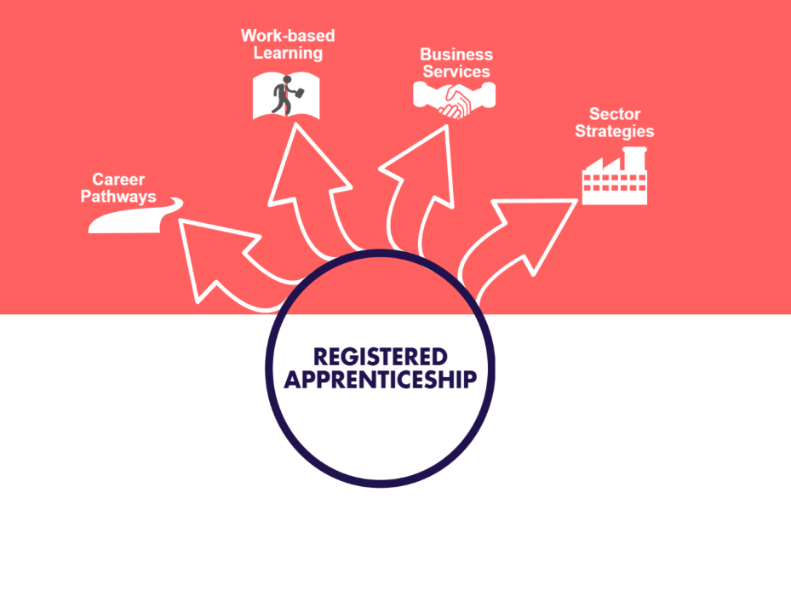

Slide 62
Alignments and Efficiencies
Goal: Integrate registered apprenticeship as a key component in
State workforce strategies by:
Cross-training for apprenticeship and Worksource Oregon (WSO) staff;
Increasing data sharing capacities between agencies;
Use WSO Sector Strategies and Employer Engagement capacity to assist employers in developing structured work based learning and apprenticeship programs;
Provide employers, local boards and community colleges support to expand RA in any occupation with demonstrated demand.

Slide 63
Barriers
Lack of knowledge or understanding of registered apprenticeship by employers and the workforce system;
Insufficient data sharing capacity;
Underdeveloped connectivity between registered apprenticeship and career pathways and sector strategies.

Slide 64
Recommendations
Develop relationship building between ATD and workforce partners;
Develop processes for data and making referrals;
Changing the conversation about apprenticeship;
Identify start up funding for industries interested in starting apprenticeship programs.

Slide 65
Oregon Workforce System Performance Measures
Performance Reporting Information System Measures (PRISM)
Partners:
Department of Human Services
Employment Department
Higher Education Coordinating Commission
Measures:
Employment Rate
Median Earnings
Credential Rate
Measurable Skill Gain
Services to Employers
Wage Gain
Business Satisfaction
Individual Satisfaction
Oregon’s Workforce System
Notes:
DHS
TANF JOBS
VR
OED
Employment Services
HECC
TI
TII
CCs
Future:
DHS
TANF- All
SNAP
OED
Unemployment Insurance
Trade Act
HECC
Higher Education
ODE
K-12
Potential:
BOLI
Dept of Corrections

Slide 66
Moving PRISM Forward
2013: Grant awarded from the U.S. Department of Labor for
PRISM redesign / upgrade.
    Goals:
    Develop new workforce performance measures.
    Develop new data sharing and analysis system.
    Develop new online, user-friendly data tools.
    Link workforce and education data.
https://www.qualityinfo.org/pm
Oregon’s Workforce System
Notes:
The basic principles of PRISM are still of immense value, but the technology and measures needed to be updated & realigned, and we also saw an opportunity to increase the power of PRISM by expanding the number of participating partners/programs.
In 2013, OED received a WDQI grant from the U.S. DOL. (Note that “align with WIOA” is now a goal, and supersedes some of the new Oregon measures that were developed prior to WIOA.)
We’re changing the measures to align with WIOA and the current goals of the state and local workforce boards.
The new PRISM is being built to report on the six WIOA measures, along with four additional Oregon measures. (See handout)
We’re adding new participants like SNAP, higher education, and UI. (See handout)
We’re developing a user-friendly web site. (Screenshots on next slides)
Q: PRISM 2.0 data tools on QualityInfo: What’s there? What’s coming?
Full suite of Customer Satisfaction data tools is available (Summary, Point-In-Time, and Time Series reports)
Summary reports are available for seven out of nine measures. (Credential Rate and Measurable Skill Gain are pending receipt of education data.)
Point-in-Time reports for remaining measures are planned for release by July 2017.
Time Series reports for remaining measures are planned for release after completion of Point-In-Time reports.
Q: When will all partners (including new partners) have their data in the system?
Partner data will be added as partners begin submitting their quarterly files; end users will know what partner data is included in the system based on what partners appear as filtering options in the QualityInfo data tools.

Slide 67

Oregon’s Workforce System

Slide 68
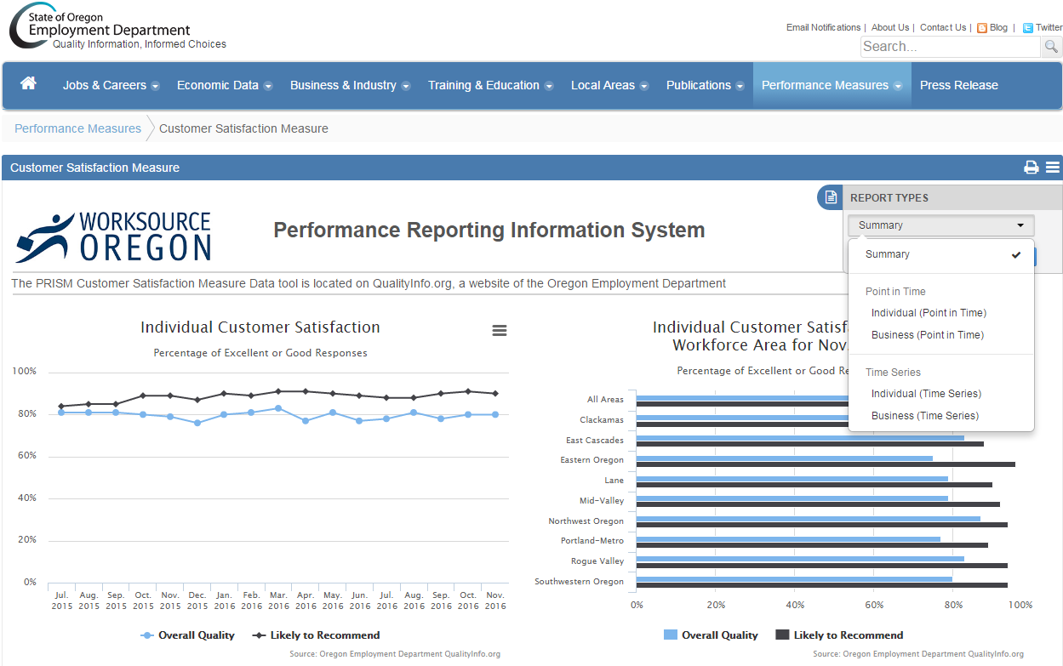
Oregon’s Workforce System
Oregon’s Workforce System
Notes:
Screenshot from Customer Satisfaction summary report on QualityInfo.org.
Other available report options are shown in the collapsible “Report Types” menu that is open on the top right.

Slide 69
System Barriers
Lack of high level communication of the vision of a unified, solution-based model that is implemented consistently by all workforce system partners.
Program focused, rather than customer focused structures are a barrier to ensuring customers are served holistically regardless of funding stream or program.
Outdated technology systems create a barrier to collect, share and analyze detailed outcomes of our collective investments. Uniformity of collected data elements and a common, accessible repository for the data is critical.
Oregon’s Workforce System

Slide 70
System Barriers
Non-standardized data sharing agreements across agencies and programs make collaboration more challenging.
Federal requirements, restrictions and definitions can prohibit the most efficient use of dollars and flexibility to focus on targeted populations.
Performance mandates are negotiated by each federal funding agency, creating inconsistent goals for each program and furthering challenges to our system approach to serving Oregonians.
Oregon’s Workforce System

Slide 71
System Funding
Engage federal funding agencies to increase flexibility in program and eligibility requirements that would optimize serving Oregonians including strategic waivers.
Agencies are very successful in discretionary funding opportunities, but complex legislative, fiscal and data systems create lags in getting funds to Oregonians quickly.
Investments in vocational preparatory activities have not included requirements to work across programs-agencies. This creates a gap between secondary and postsecondary levels of career and technical education to better prepare Oregonians for the workforce.
Oregon’s Workforce System
Notes:
Apprenticeship
SNAP 50-50
Data Collection
WIOA frames up…we are ahead on collaboration Barriers- data sharing, funding

Slide 72
System Recommendations
Expand leadership table to include Business Oregon and other key agencies that support businesses.
Review, improve and standardize data sharing agreements across agencies and programs.
Assure that intersections among data and technology systems are considered as agencies modernize their systems.
Expand capacity to analyze data and inform policy decisions.
Oregon’s Workforce System

Slide 73
System Recommendations
Conduct a comprehensive review of existing data and reporting systems across programs to identify and resolve incompatibility or gaps.
Develop a common methodology that is consistent across workforce system programs to enable like comparisons for prioritization and investment decisions.
Fully utilize the business led Oregon Workforce Investment Board to continue accountability and improvements in the system.
Oregon’s Workforce System

Slide 74
Coming Thursday: Local Workforce Boards and Businesses

Slide 75
Thank You
Oregon’s Workforce System

